Slide 1
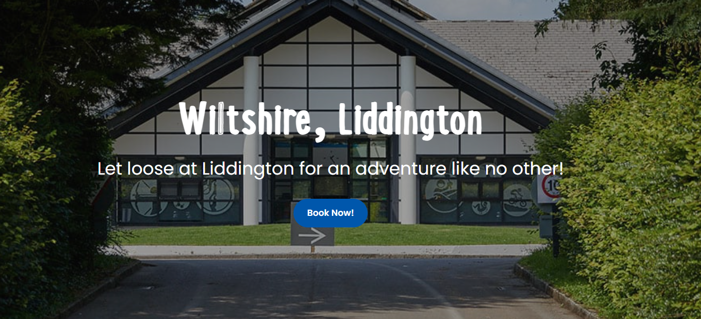
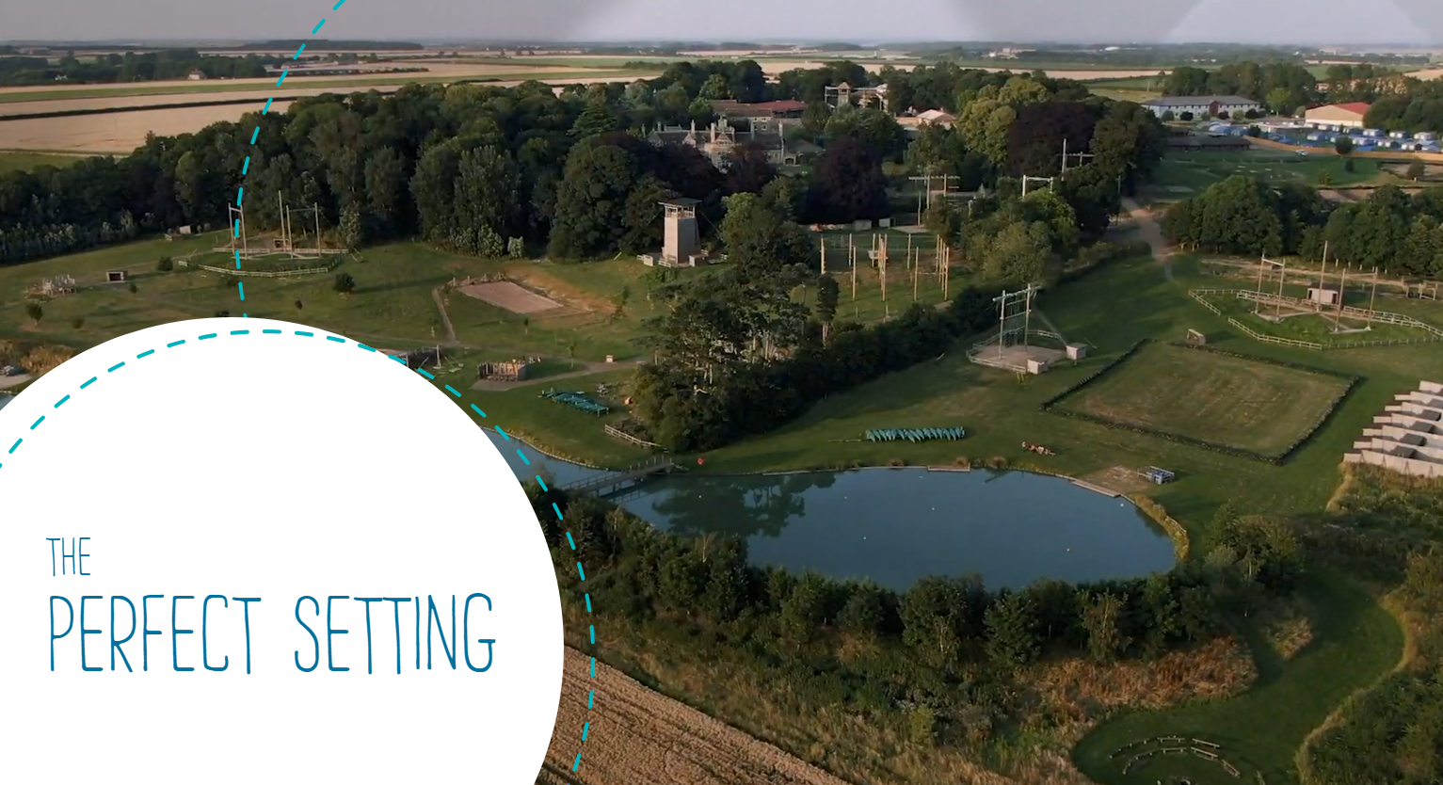

Slide 2


Slide 3
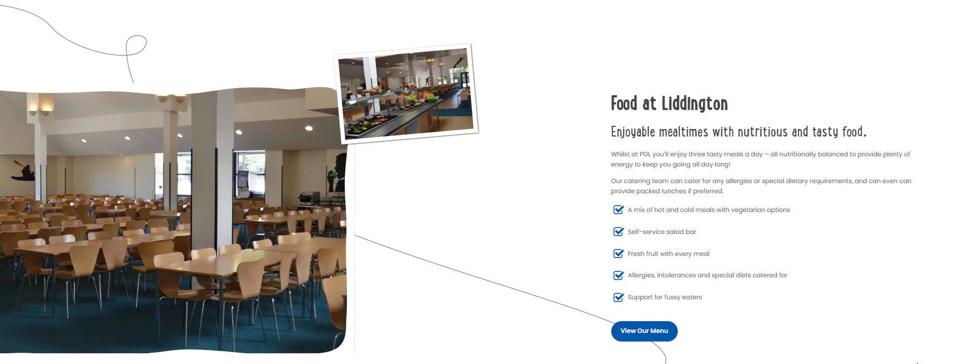
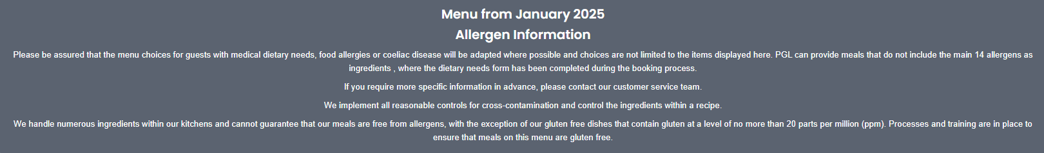

Slide 4
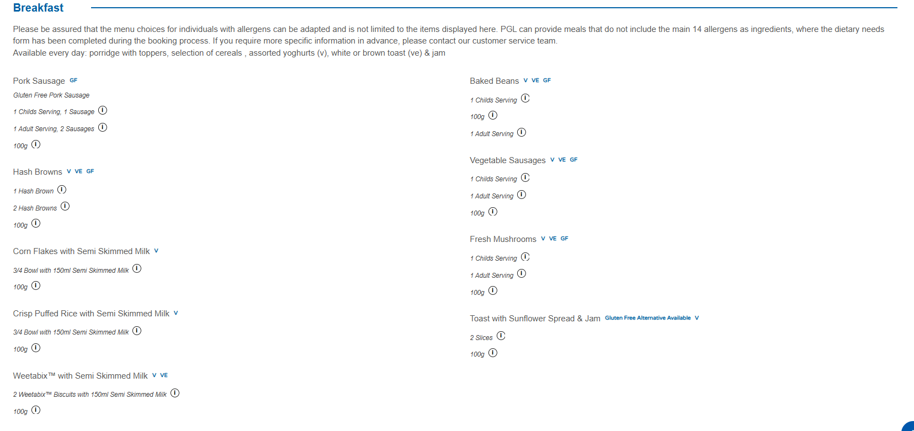

Slide 5
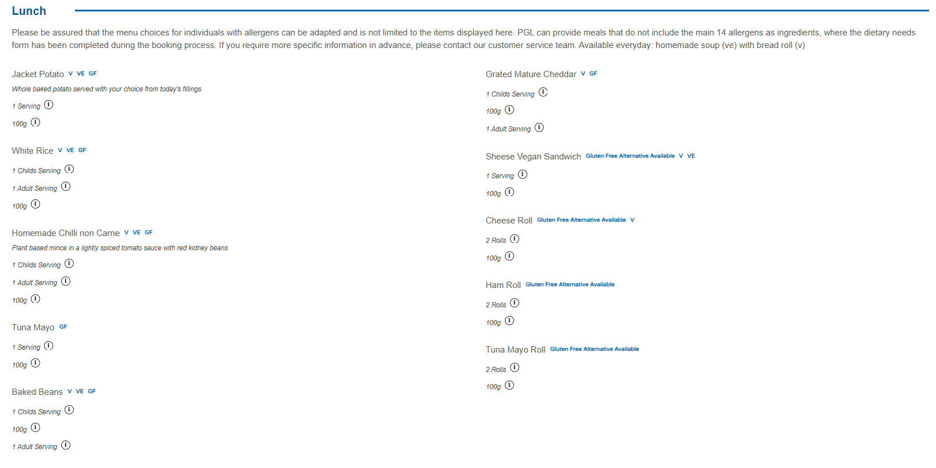

Slide 6
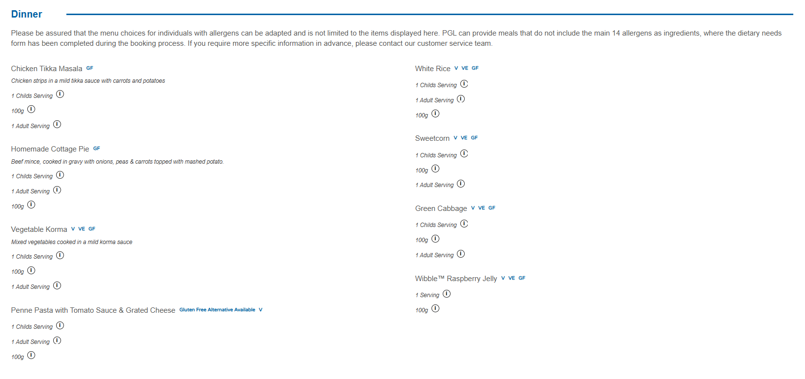

Slide 7
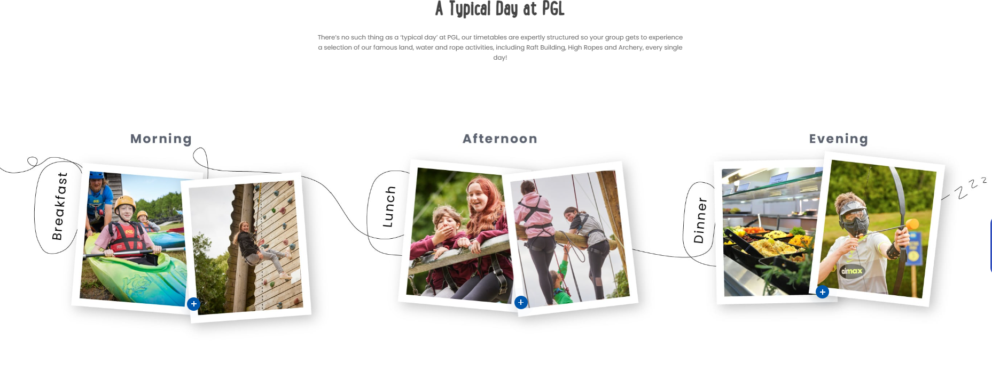


Slide 8
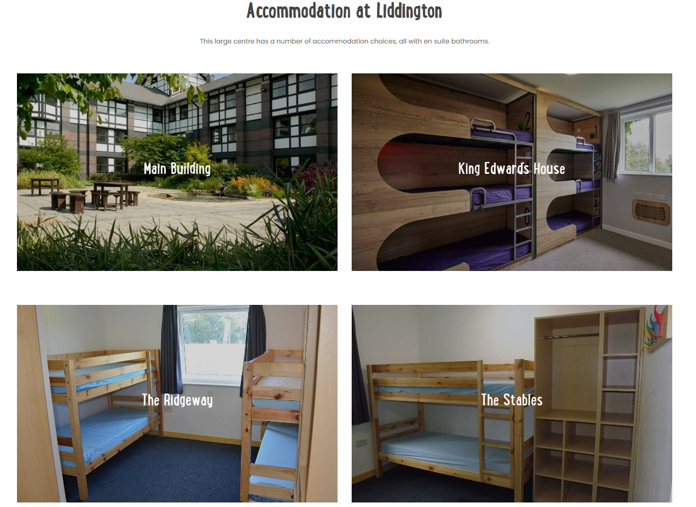
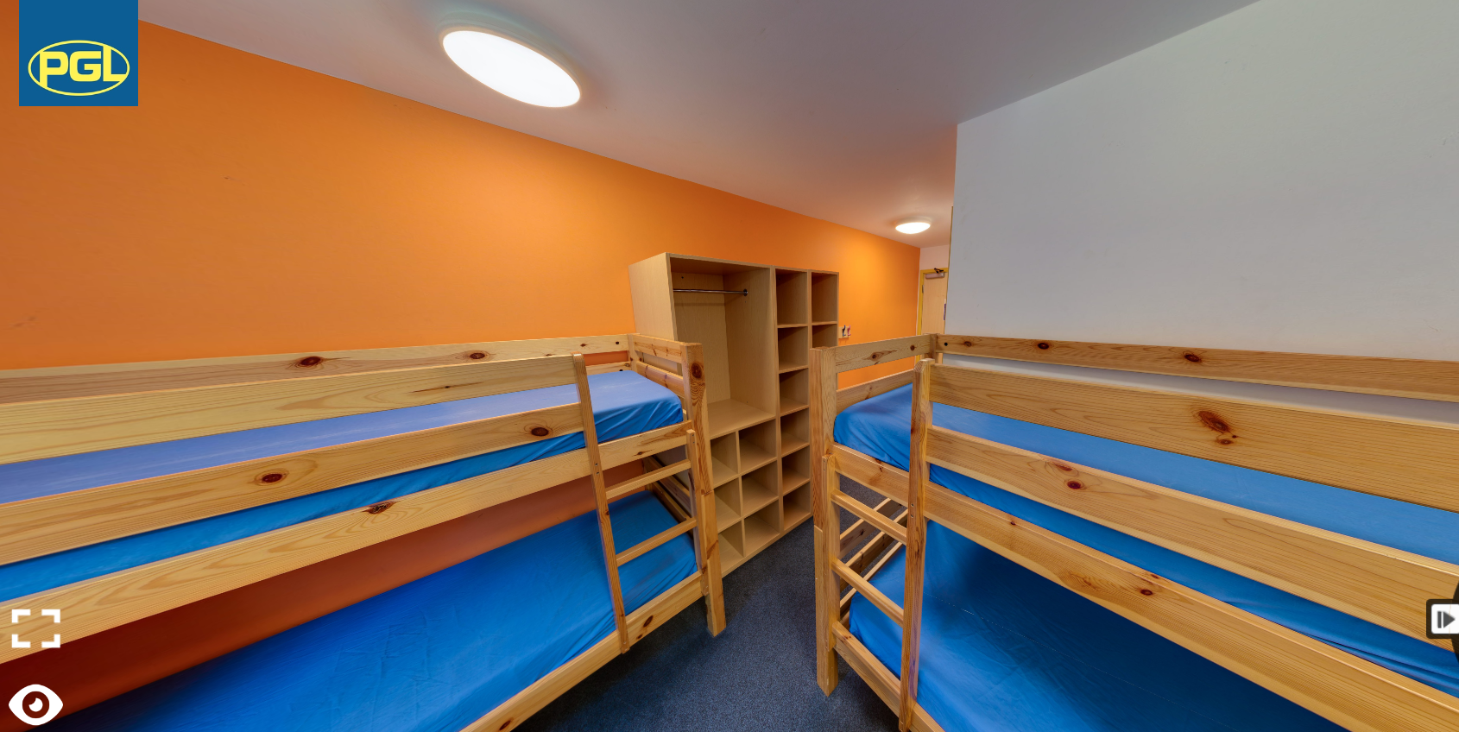

Slide 9
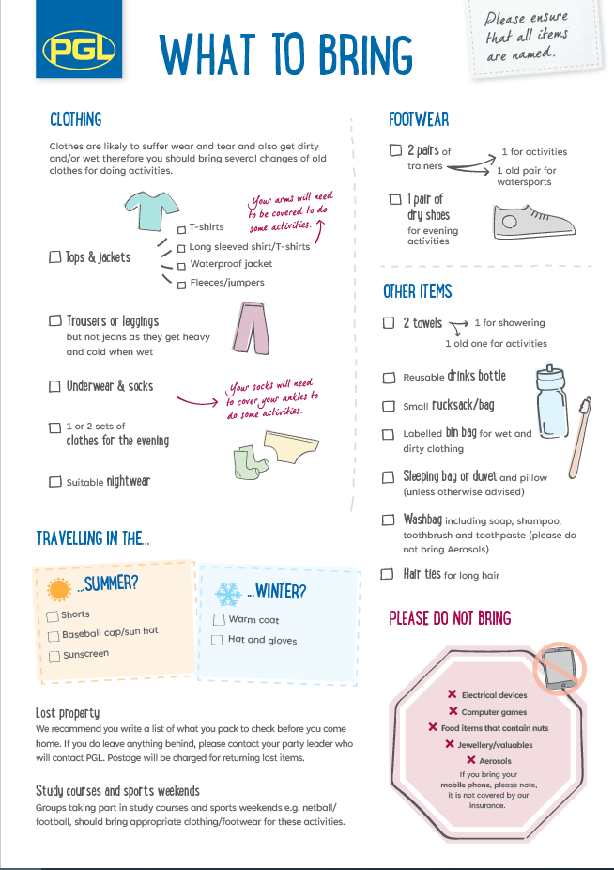
On Monday 31st March children will need to bring a packed lunch with them to eat when we arrive at the centre.
Normal school rules apply for consumables but the food will need to be in a plastic bag so the children can put all their food wrappers and leftovers in a bin at the centre.
Children will also need to bring.
Pyjamas
Torch
Teddy
Pillow and sleeping bag
Wash gear – tooth brush, hair brush, showering bits and bobs.

Slide 10
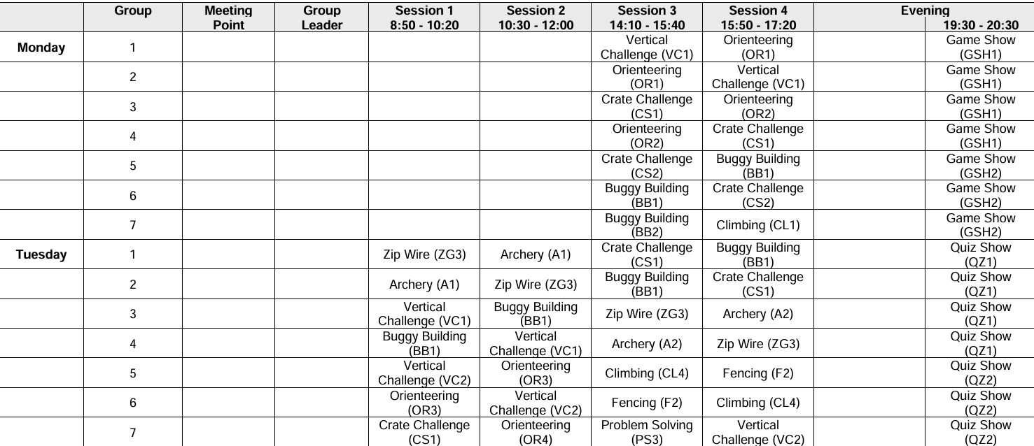

Slide 11
Medication
You have all been sent a medical information form.
Any medical conditions we are already aware of have been passed to the site, however, please inform the school of any changes to medication.
If your child is travel sick please provide teachers with the relevant medication on the morning of the trip, with written instructions.
All medication will be handed in to staff on the morning of the trip and looked after by the group leaders.

Slide 12
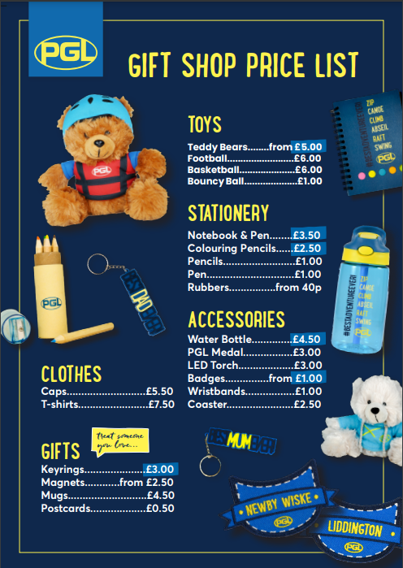
Maximum of £10
Please make sure all money is in a labelled bag/wallet,
class teachers will lock money away in their rooms until our
designated times.

