Slide 1
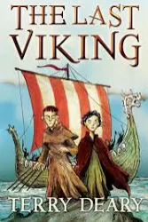

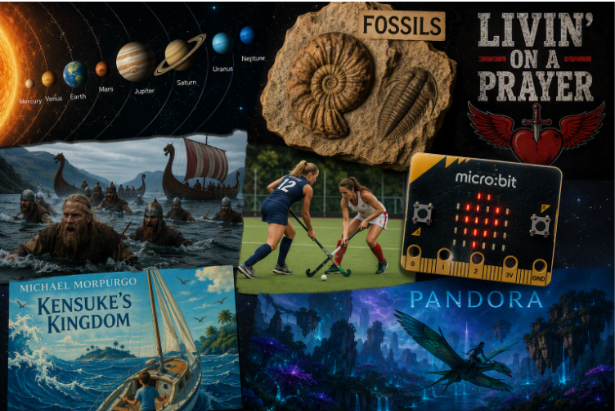


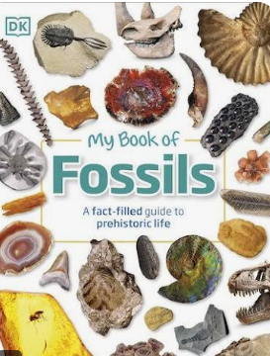
Home learning
The children are expected to read at least four times a week for a minimum of 15 minutes. We encourage parents to ask questions to check their child understands and can explain their thinking.
There will also be one to two pieces of curriculum based work either on My Maths or Rollama. These should be completed by pupils within a 45 minute time frame.
The children will also bring up to 10 words home for spelling homework. These should be learnt using the look/cover/write/check method.
Work will be set on a Thursday and should be returned by the following Tuesday. Please also use the websites listed to help your child consolidate their learning
Autumn Term in Year 5
We are delighted to welcome your child into Year 5 at Kempshott Junior School. As we start the new school year, the children will be exploring many exciting new topics. We will also focus on consolidating the key concepts they have already learned so they can continue to broaden their knowledge, skills, and understanding. We highly value the partnership between home and school. I hope that the following information is useful in helping you support your child at home with their learning over the coming weeks.
Useful websites & Books
History
BBC Bitesize: https://www.bbc.co.uk/bitesize/topics/ztyr9j6
Horrible History clips linked to the Vikings: https://www.youtube.com/watch?v=IDzGv2mEazs
Science
BBC Bitesize – Fossils: https://www.bbc.co.uk/bitesize/articles/zt3ntrd
BBC Bitesize – Space: https://www.bbc.co.uk/bitesize/topics/zkbbkqt
Key Dates:
Swimming lessons start on Wednesday 9th September for twelve weeks.
Inset days for this term:
1st September 2026
2nd November 2026

Slide 2





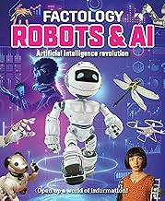

Maths:
This term, we look forward to continuing the learning journey from last year, extending and developing the core topics the children have already explored, and allowing for the children to grow in confidence through practice, repetition and open ended problems.
The following topics are coming up this term:
Number & Place Value:
Read, write, compare, and count forwards and backwards in steps of 10 to 100,000 for numbers up to 1,000,000.
Addition & Subtraction:
Master mental strategies and formal written column methods for large numbers to solve multi-step problems and check answers using inverse operations.
Multiplication & Division:
Multiply and divide mentally using known facts, scale numbers by 10, 100, and 1,000, and apply methods like partitioning to solve problems.
Fractions, Decimals & Percentages:
Read, order, and convert numbers with up to three decimal places, identify equivalent fractions, and connect percentages to fractions and decimals.
Measurement:
Read and convert between 12-hour and 24-hour digital or analogue clocks, calculate durations, and convert between various metric and imperial units.
Geometry & Position:
Classify 2D/3D shapes, estimate angles, identify parallel/perpendicular lines, and read, plot, or translate coordinates in the first quadrant.
English Writing
In Writing we shall be looking at a range of written texts and film clips to write for a range of purposes, including:
Letter writing
Diary entries
Poetry and figurative language
Non-Chronological Reports
We will continue to practice core skills including handwriting and spelling as well as developing our use of:
*Prepositional phrases
* Sentence types for effect
* Direct and reported speech
* Paragraph cohesion
NB – We ask parents not to read these books/watch the clips before hand.
English Reading
This term we shall be reading a range of fiction and non-fiction texts.
We will continue to develop our skills of:
* Understanding authors use of language
* Retreieval
* Inference
Please see the planner for a range of questions you can ask at home to support with reading.
A range of recommended reads can also be found on the website: https://www.kempshott-jun.hants.sch.uk/page/?title=Reading&pid=100

Slide 3
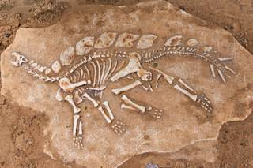
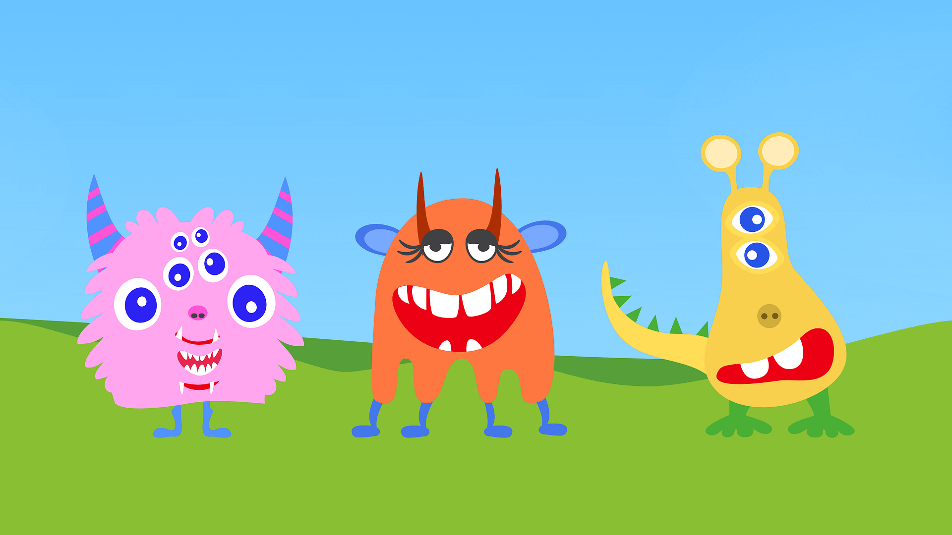
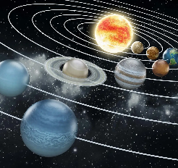
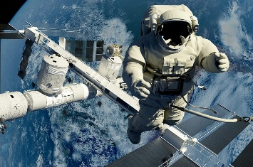


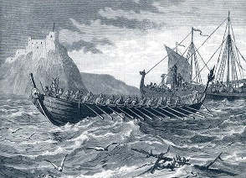
Science
Fossils, geological time and
classification
The Big Question: What is evolution and how do we know it happened?
We will learn about:
Geological time
The evidence for evolution
Classification of life.
Space and Gravity
The Big Question: What is Earth’s address in space?
We will learn about:
Our Solar System
What else is in the Solar System
Gravity and its effects.
French
French Monster Pets
We will learn to:
To investigate a text for clues to understand new words.
To identify nouns by their gender, number and meaning.
To apply knowledge of French nouns and gender agreement to a short piece of writing.
To develop understanding of adjectival rules in French.
Space exploration in French
We will learn to:
* To identify keywords, phrases and ideas from spoken French.
To apply knowledge of noun and adjective agreement to create metaphors in French.
To make comparisons in French.
RE
Belonging: Shahada and Salat (Islam)
We will learn this through exploring these questions:
What does belonging mean to me?
How does belonging make us feel?
What does belonging mean?
How do Muslims show they belong?
Why is belonging important is Islam?
Community: Birth narratives (Christianity)
We will learn through exploring these questions:
What does interpretation mean?
What does interpretation mean in the birth narratives?
What is the value of the different interpretations to Christians? What do
I think?
What does interpretation mean
  to me?
On what occasions and in what
  situations is interpretation
  Significant?
Music
Livin’ on a prayer
We will learn to:
To identify the piece’s structure, instruments/voices included in the piece along with using musical elements such as dynamics, texture, timbre, etc..
To use glockenspiels to accompany a piece using given notation.
To compose a melody using simple rhythms and use as part of the performance. Using the notes: G, A + B.
Children can contribute to the performance by singing, playing an instrumental part, improvising or by performing their composition.
To evaluate their performance discussing their thoughts and feelings towards it afterwards.
History
British history: Were the Vikings raiders, trades or something else?
We will learn:
To explain when and why the Vikings came to Britain.
To evaluate ideas about the Vikings using sources.
To understand the importance of Viking trade and trading routes.
To compare different versions of Viking sagas.
To evaluate the impact of the Viking invasions and settlements using primary sources and case studies.
To evaluate achievements of the Vikings.

Slide 4






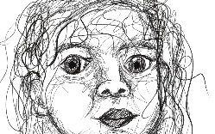

PSHE
Me and My Relationships
We will learn to :
To explain what collaboration means.
To explore the terms negotiation and compromise.
To demonstrate how to respond to a wide range of feelings in others and reflect on their own friendship qualities.
To identify characteristics of passive, aggressive and assertive behaviours.
To recognise basic emotional needs, and understand that they change according to circumstance.
Valuing Difference
We will learn to:
To define some qualities of friendship.
To rehearse active listening skills.
To develop an understanding of discrimination and its injustice, and describe this using examples.
To describe the benefits of living in a diverse society.
To understand that the information seen online is not always true.
DT
Digital World: Monitoring
Devices.
We will learn how to:
To carry out research to develop design criteria.
To write a program to monitor the ambient temperature, including an alert.
To generate creative and unique Micro:bit case, stand or housing ideas.
To learn about and practise 3D CAD skills.
PE
Swimming
We will learn to:
To perform a self-rescue in different water based situations
Swim competently, confidently and proficiently over a distance of at least 25 metres.
To use a range of strokes effectively.
Hockey
We will learn to:
To understand basic skills and rules to play modified, competitive games of hockey.
To dribble confidently using tight turns, turning the stick over to control the ball.
To receive and pass accurately on both sides of the stick, including using the reverse stick.
To cross from the byline, and shoot using a sweep hit.
To work with teammates to move past defenders to score, and review game performance to improve.
Dodgeball
We will learn to:
To acknowledge and practise some of Dodgeball’s key elements.
To begin to apply the skills I have practised to a competitive Dodgeball game.
To practice game based situations and to consider ways of developing their performance.
To consider the progression from grass roots to professional for all sports.
Computing
Systems and Searching
We will learn to:
To explain that computers can be connected together to form systems.
To recognise the role of computer systems in our lives.
To identify how to use a search engine.
To describe how search engines select results.
To explain how search results are ranked.
To recognise why the order of results is important, and to whom.
Vector Drawing
We will learn to:
To identify that drawing tools can be used to produce different outcomes.
To create a vector drawing by combining shapes.
To use tools to achieve a desired effect.
To recognise that vector drawings consist of layers.
To group objects to make them easier to work with.
To apply what I have learned about vector drawings.
Art
Drawing: Depth, emotion and
movement
We will learn how to:
To apply and understanding of expressive and gestural lines to capture movement.
To understand how lines and marks can communicate emotion.
To understand how artists use mark making and shading to create depth.
To apply an understanding of composition to plan a print.
To develop drawn ideas through printmaking.
To explore how portraits can show expression and emotion and affect how we see the artwork.

